Slide 1


S.S Agrawal Institute of Engineering & Technology, Navsari
Computer Engineering Department
Semester: V
Subject: Summer Internship-II (4350704)
Food-Ordering Website
Prepared By:
Nitesh P. Nadar
Faculty Mentor:
Prof. Bhavana B. Ahir
Industry Mentor:
Mr. Meet Patel

Slide 2
OUTLINE
Purpose of Internships
Company Profile
Internships timeline
Internships Activities
Moving Forward/Future Work
Project Outcomes
Conclusion
References

Slide 3
PURPOSE OF INTENSHIP Enhancing Skills and Gaining Experience in Software Development
Gain Practical Experience
The internship focused on applying theoretical knowledge in real-world scenarios.
Collaborations with team member
involves working together to share ideas,tasks,resource and to archieve comman project goals
Exposure to Real-World Projects
Interns worked on genuine projects, fostering a deeper understanding of software development.
Faster Professional Growth
The program aimed to support career development through hands-on learning and mentorship.

Slide 4

Introduction to company profile
Company Name: TechFusion Technologies
Company Address: S-1/2 Dhir Complex Opposite Samarpan Sadhak Nivas, Eru-Abrama Rd, Vejalpore, Navsari, Gujarat 396445
Website URL: https://techfusiontechnologies.com
Company Type: Software Development.
Company services:
Web designing
Web development
Android Application

Slide 5
Intenship Timeline
Structured six-week program with key learning milestones
Week-1
Introduction to Firm and environment setup
Week-2
Revision of basic basic python
Week-3
Basic of Flask
Week-4
Flask with Database
Week-5
Using Bootstrap for Front-End
Week-6
Working on mini project

Slide 6
Intenship Activities and training Work Engaging in Practical Knowledge and Experience
Software Development Meetings-
Participated in meetings to discuss project requirements and updates.
Flask Development-
training teaches you to build and deploy web application using python’s flask framework
Project collaboration with team-
involves working together to share ideas,tasks,resource and to archieve comman project goals
Hands-On Coding-
Engaged in practical coding exercises to strong then programming abilities.
Debugging Tasks-
Conducted debugging sessions to identify and resolve software
issues
Collaborative Problem-
Solving-Participated in team sessions to collaboratively tackle technical challenges.

Slide 7
Moving forward: Future work Exploring Opportunities at Tech-fusion Technologies
Continued Internship Opportunities-Explore potential for ongoing internship roles tailored to your skills at Tech-fusion.
Full-Time Employment Prospects-Consider transitioning into full-time positions with Tech-fusion after your internship.
Engagement in Projects-Participate in upcoming initiatives that promote innovative solutions at Tech-fusion.
Contributing to Innovation-Contribute to cutting-edge projects that harness technology for real-world applications.

Slide 8
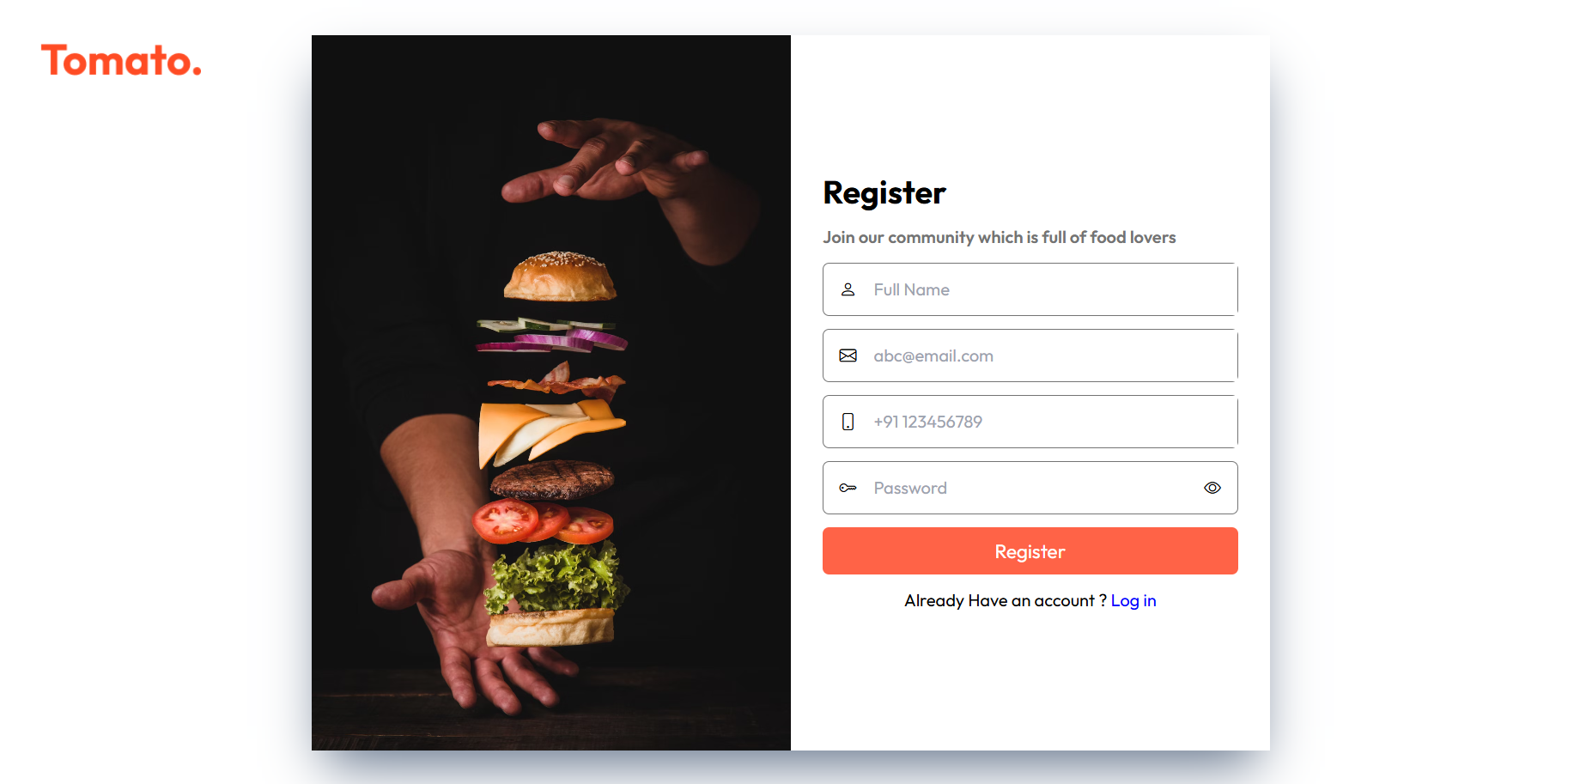
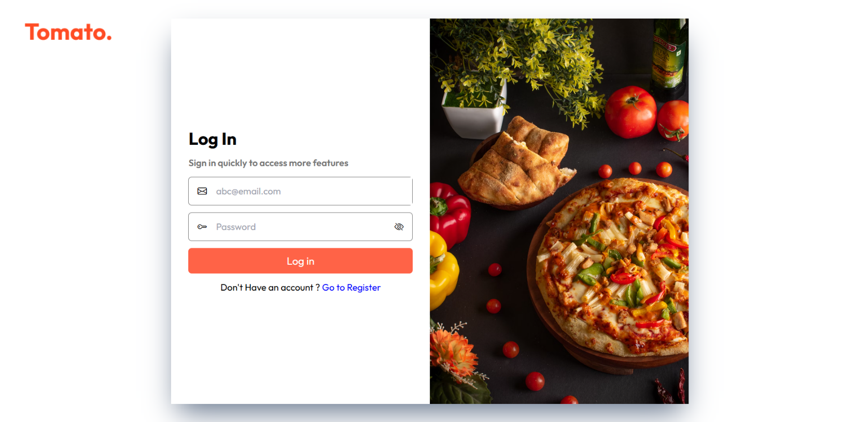
Outcomes

Slide 9
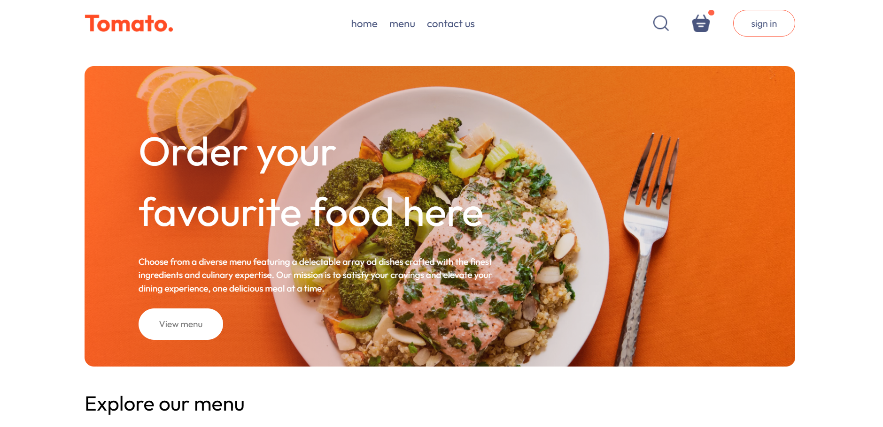

Slide 10
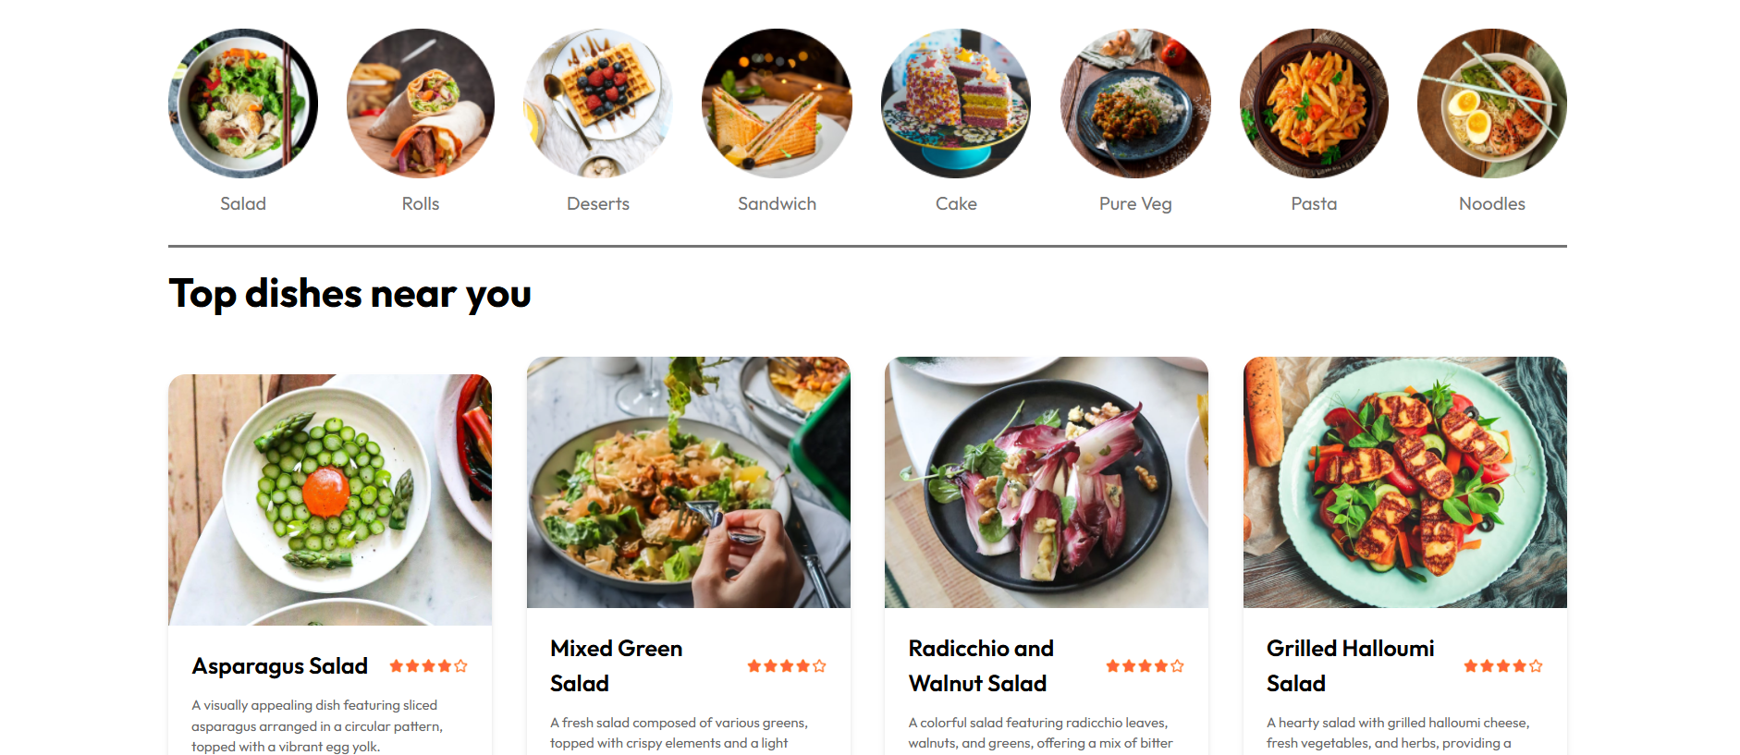

Slide 11
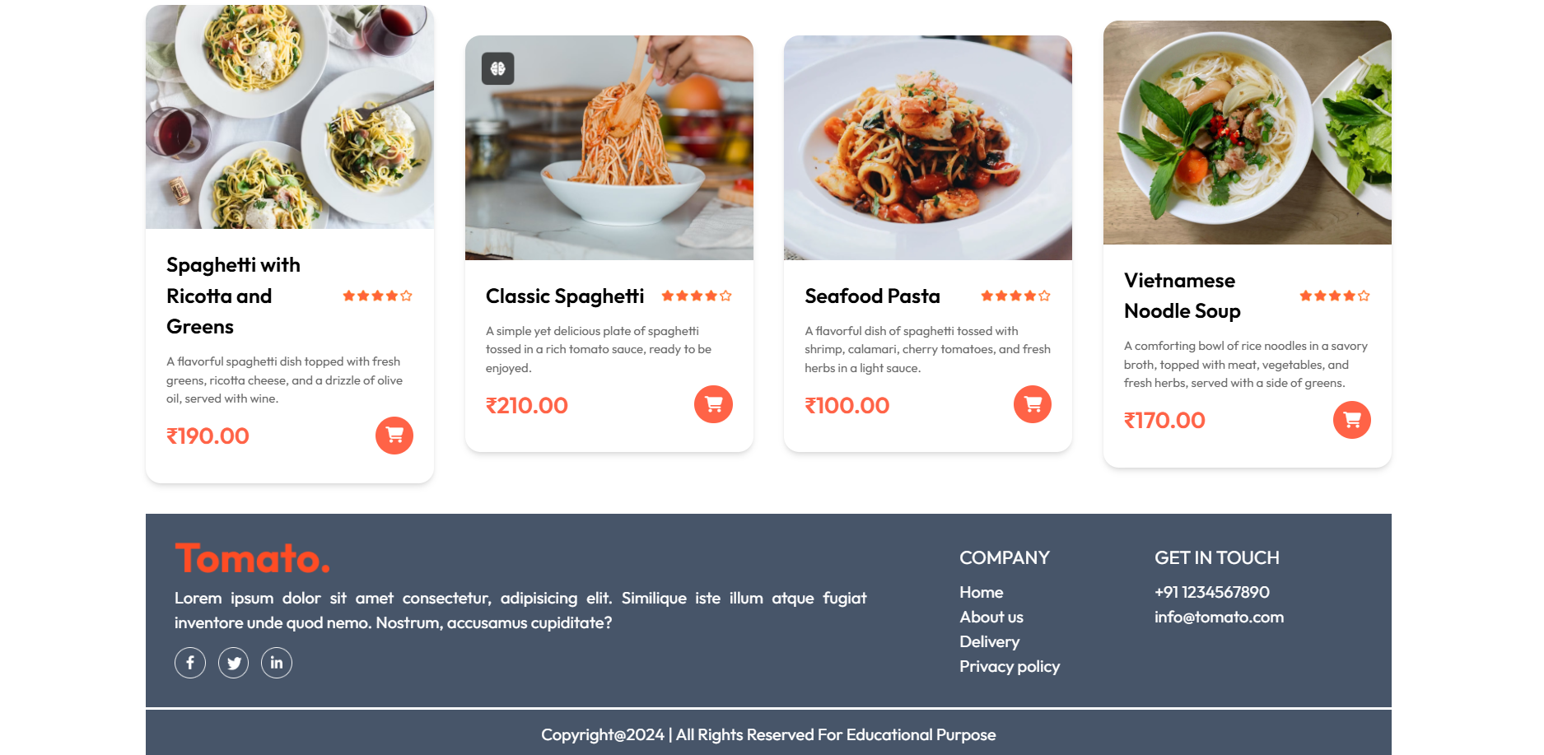

Slide 12
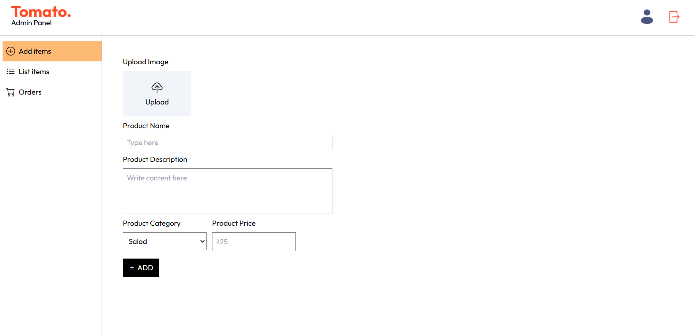
ADMIN PAGE

Slide 13
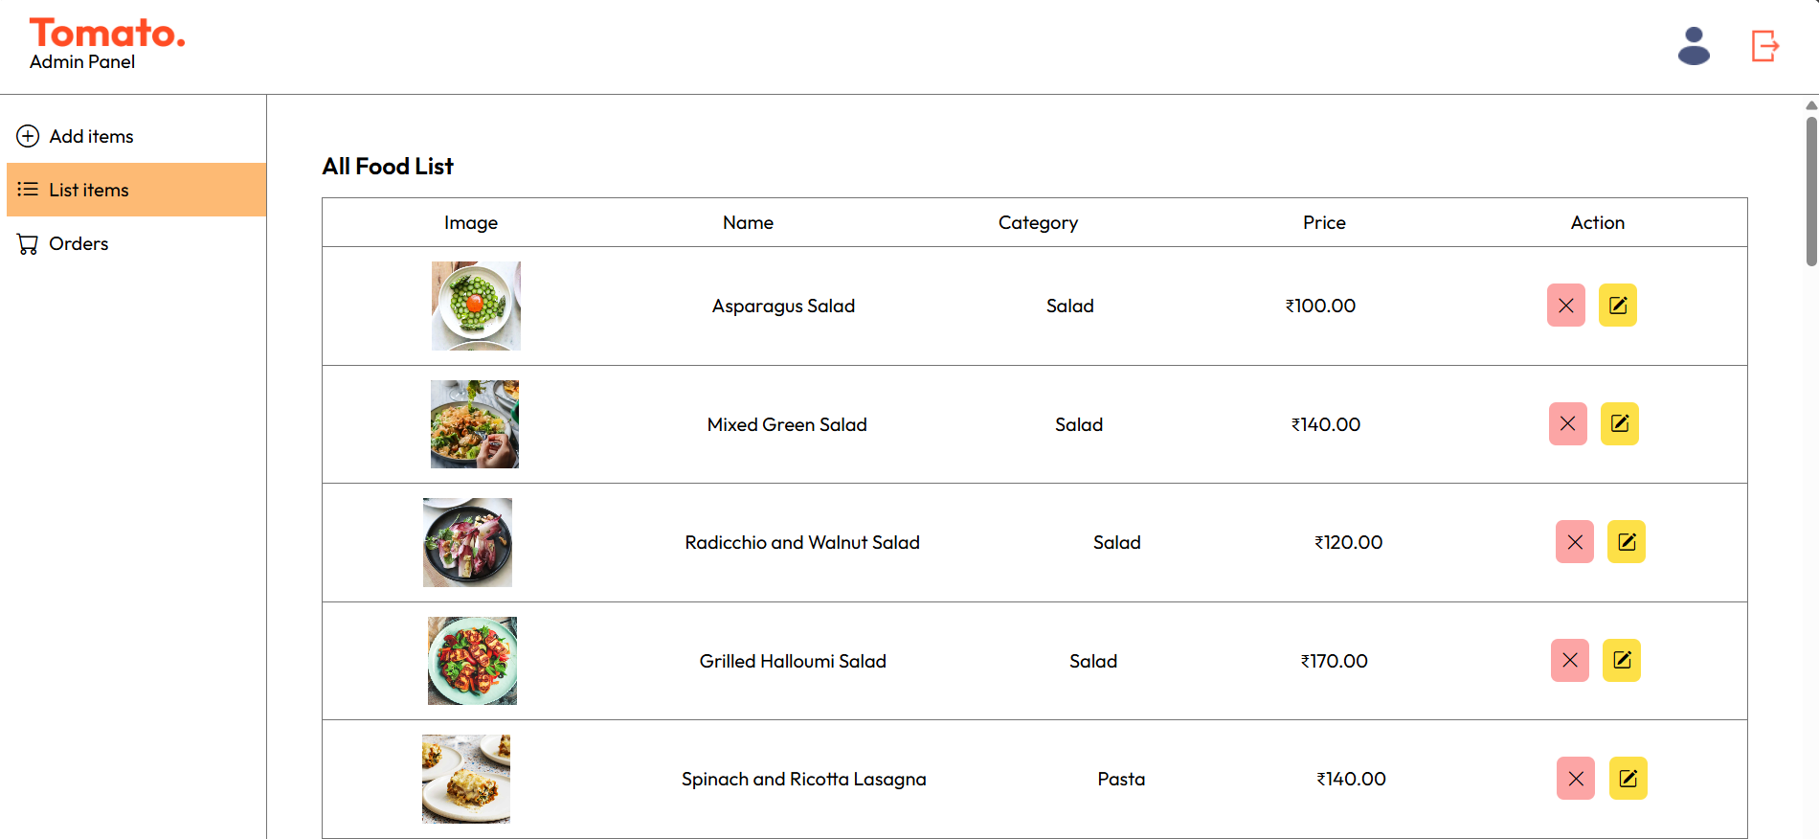

Slide 14
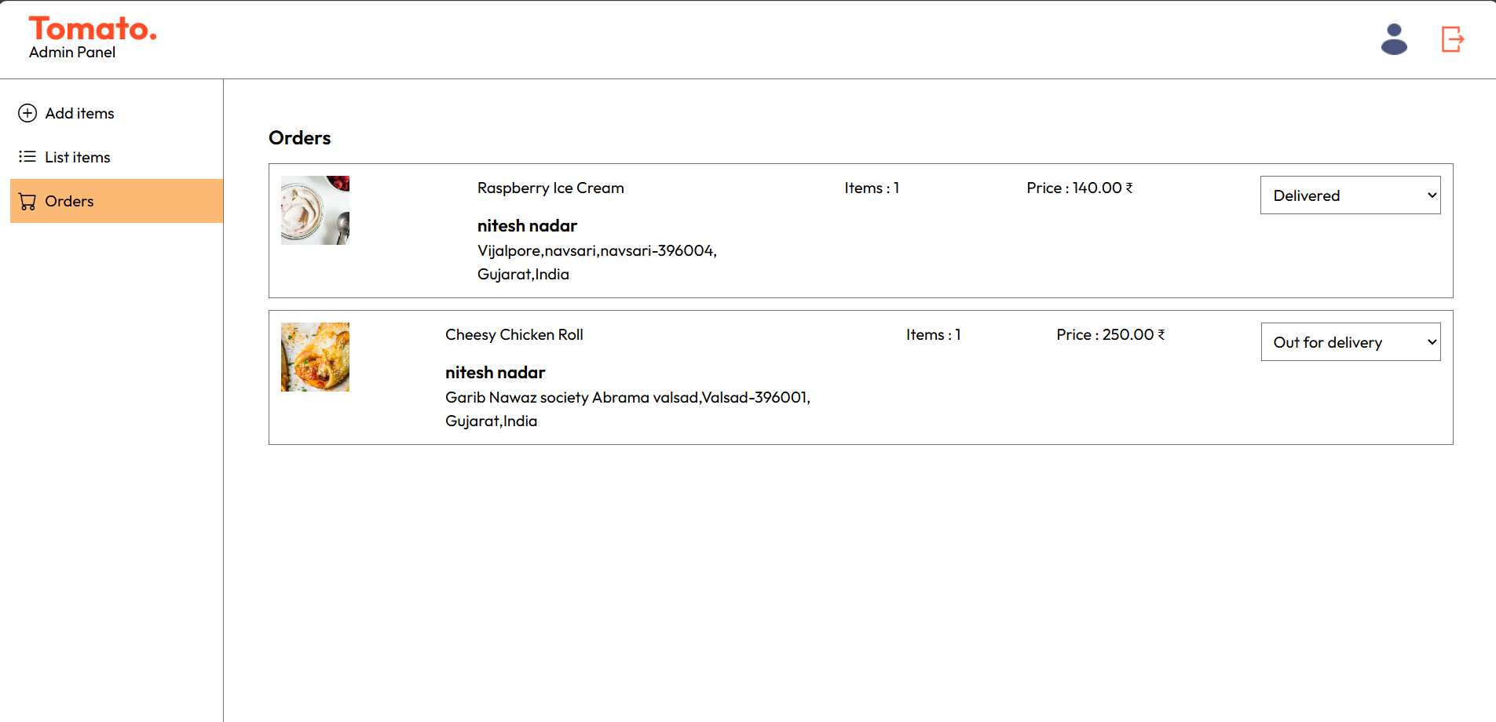

Slide 15
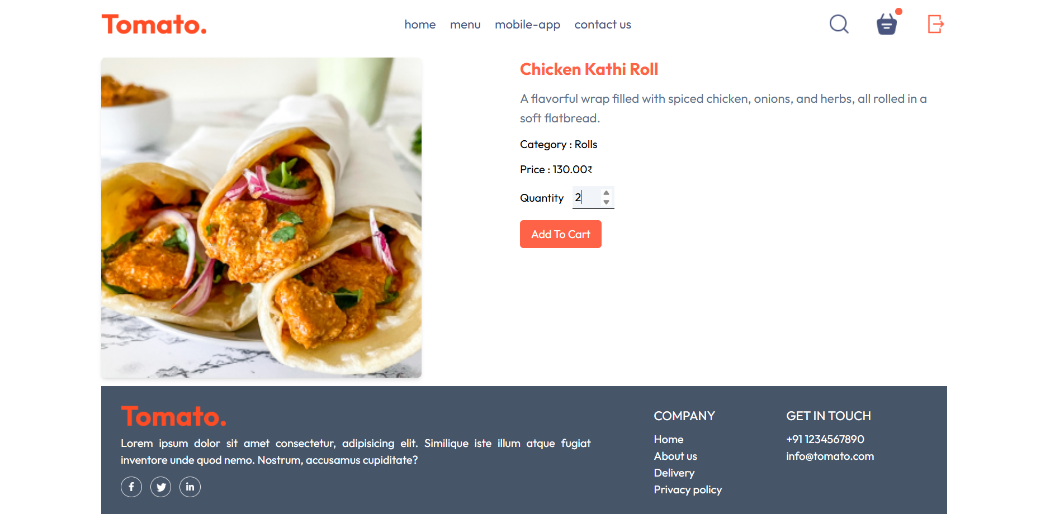
FOOD CART PAGE

Slide 16
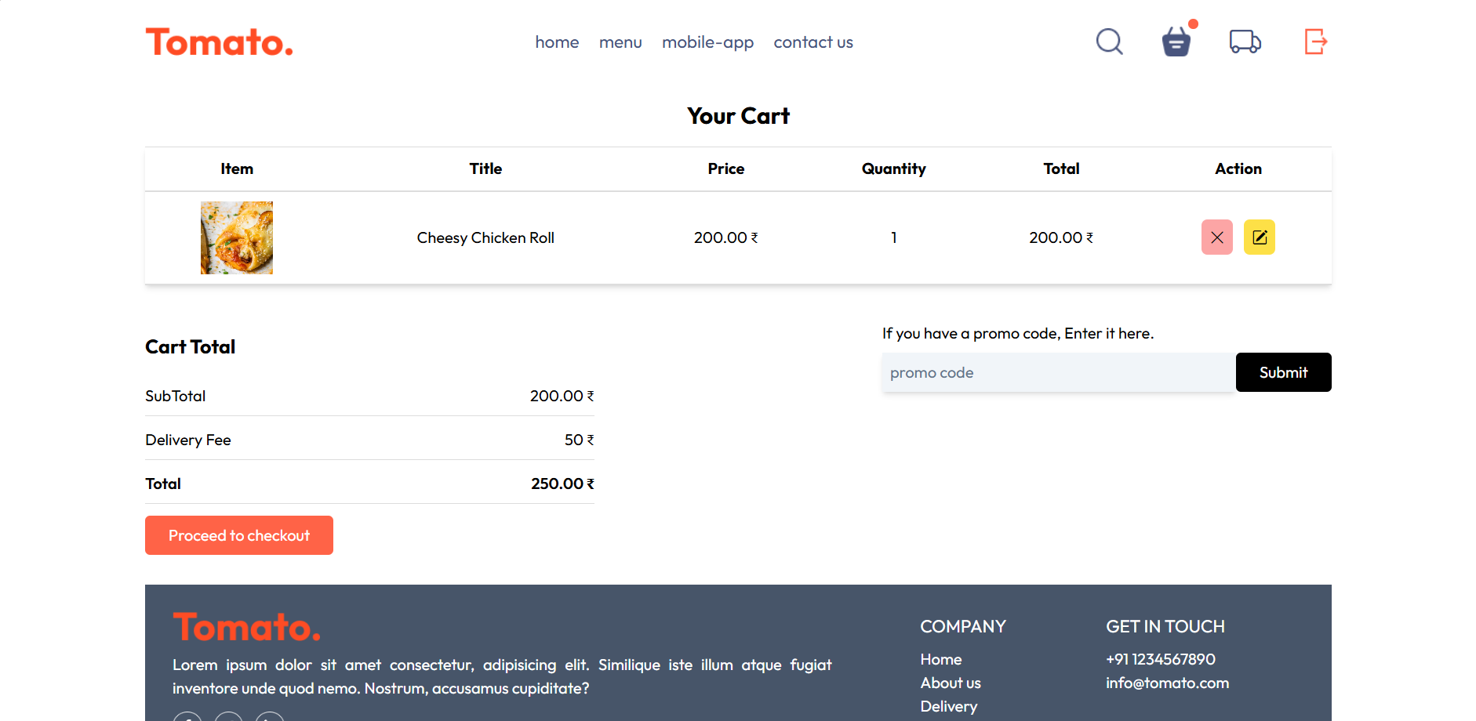

Slide 17
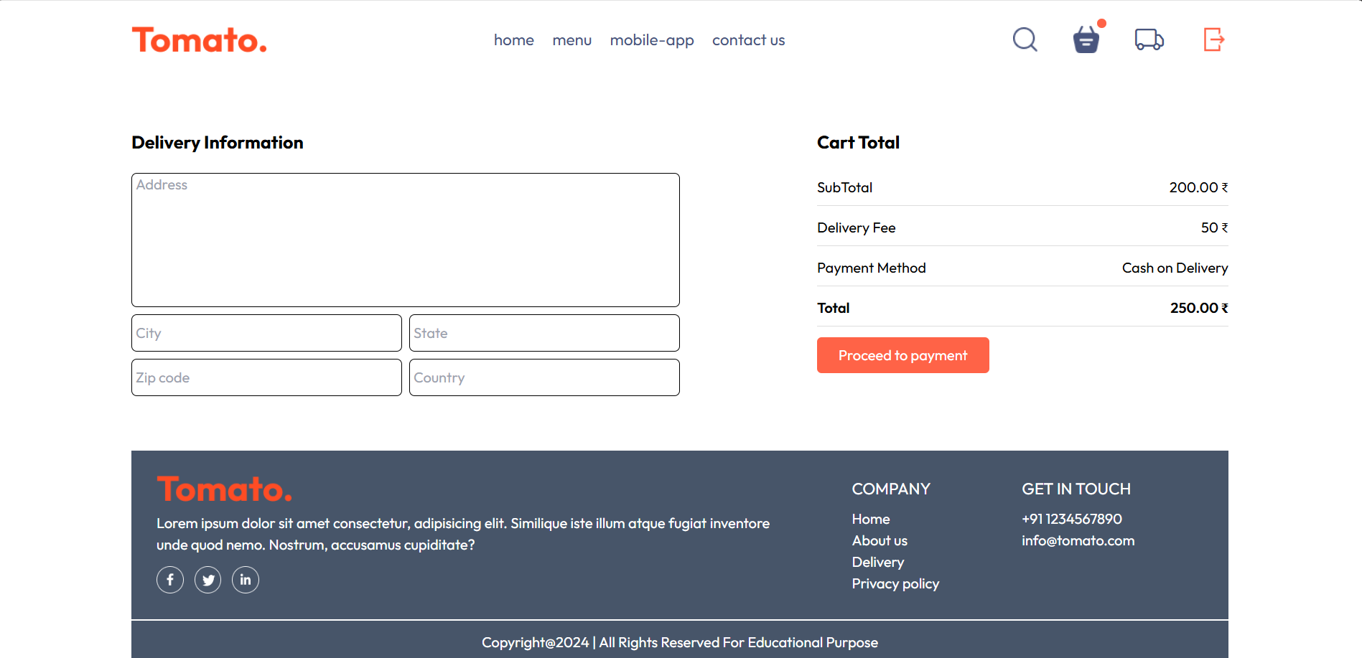

Slide 18
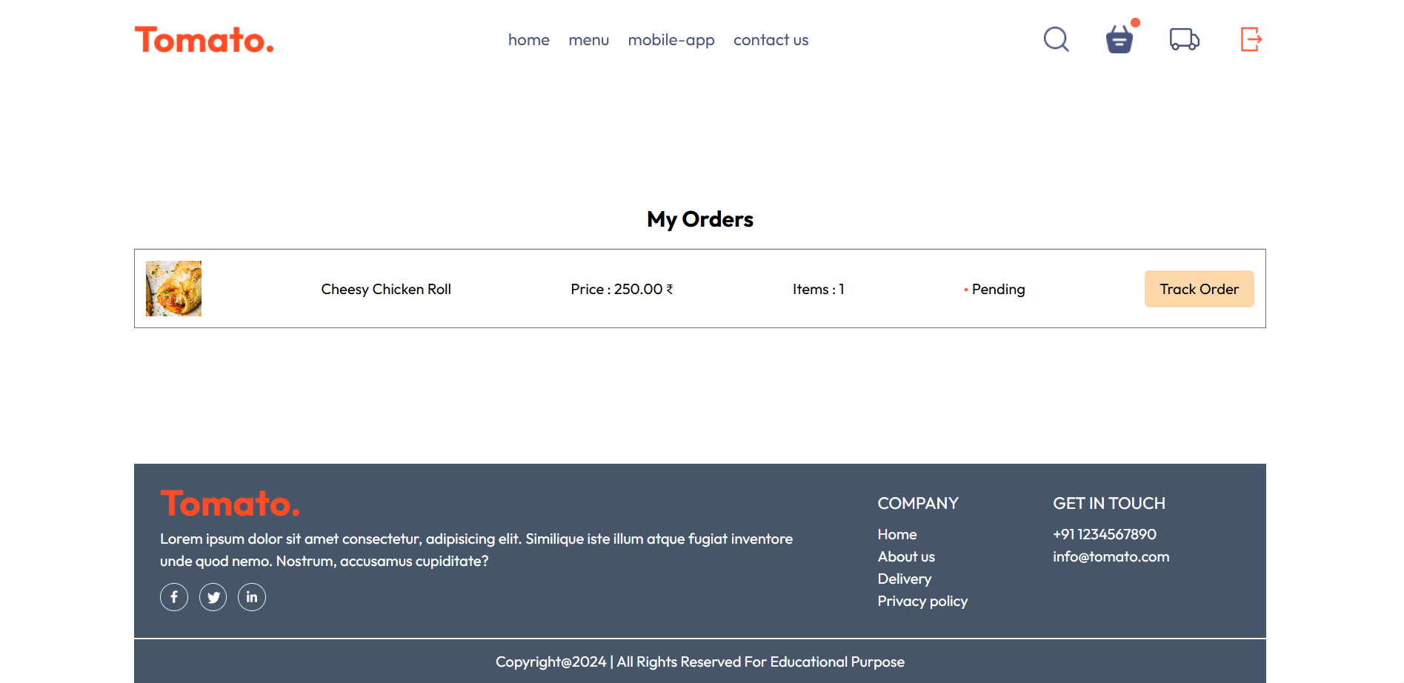

Slide 19
Conclusion
In conclusion, the development of a food ordering website offers significant advantages for both customers and businesses. It streamlines the process of ordering food, providing convenience, speed, and accessibility, while enabling businesses to expand their customer base, improve operational efficiency, and increase sales.
A well-designed and user-friendly platform ensures a seamless experience, fostering customer loyalty and enhancing satisfaction. In today's fast-paced environment, such digital solutions are essential for maintaining competitiveness and meeting the evolving needs of the market.

Slide 20
References
HTML REFERENCES
w3schools : https://w3schools.com/html/
HTML Reference : https://htmlreference.io/
CSS REFERENCES
CSS References : https://cssreference.io/
W3schools : https://www.w3schools.com/css/
FLASK REFERENCES
Tutorial point: https://www.tutorialspoint.com/flask/index.htm/

Slide 21
THANK YOU

